Slide 1
Chapter 2
Instructions: Language
of the Computer

Slide 2
Introduction
§2.1 Introduction
Language of the computer
  Instructions
  Instruction set
Design goals
  Maximize performance
  Minimize cost
  Reduce design time
Our chosen instruction set: RISC-V
  developed at UC Berkeley starting in 2010

Slide 3
Operations of the Computer Hardware
Every computer must be able to perform arithmetic
  Only one operation per instruction
  Exactly three variables(add a, b, c // a=b+c)
Design Principle 1
  Simplicity favors regularity(简单源自规整，指令包含3个操作数）
Example(p71):Compiling two C assignment statements into RISC-V
§2.2 Operations of the Computer Hardware
  C code:
  a = b + c
  d = a - e
  RISC-V code:
  add a, b, c
  sub d, a, e

Slide 4
Example:Compiling a complex C assignment
C code:
  f = ( g + h ) – ( i + j );
RISC-V code:
  add t0, g, h // temporary variable t0 contains g + h
  add t1, i, j // temporary variable t1 contains i + j
  sub f, t0, t1 // f gets t0 – t1
  RISC-V assembly language
Category | Instruction | Example | Meaning | Comments
Arithmetic | add | add a,b,c | a←b+c | Always three operands
 | subtract | sub a,b,c | a←b-c | Always three operands

Slide 5
RISC-V operands
Name | Example | Comments
32 registers | x0-x31 | Fast locations for data. In RISC-V, data must be in registers to perform arithmetic. Register x0 always equals 0.
2³⁰ memory words | Memory[0], Memory[4] , …… , Memory[4294967292] | Accessed only by data transfer instructions. RISC-V uses byte addresses, so sequential word accesses differ by 4. Memory holds data structures, arrays, and spilled registers.

Slide 6
RISC-V assembly language
Category | Instruction | Example | Meaning | Comments
Arithmetic | add | add x5,x6,x7 | x5=x6 + x7 | Add two source register operands
 | subtract | sub x5,x6,x7 | x5=x6 - x7 | First source register subtracts second one
 | add immediate | addi x5,x6,20 | x5=x6+20 | Used to add constants
Data transfer | load word | lw x5, 40(x6) | x5=Memory[x6+40] | word from memory to register
 | load word, unsigned | lwu x5, 40(x6) | x5=Memory[x6+40] | Unsigned word from memory to register
 | store word | sw x5, 40(x6) | Memory[x6+40]=x5 | word from register to memory
 | load halfword | lh x5, 40(x6) | x5=Memory[x6+40] | Halfword from memory to register

Slide 7
Category | Instruction | Example | Meaning | Comments
Data transfer | load halfword, unsigned | lhu x5, 40(x6) | x5=Memory[x6+40] | Unsigned halfword from memory to register
 | store halfword | sh x5, 40(x6) | Memory[x6+40]=x5 | halfword from register to memory
 | load byte | lb x5, 40(x6) | x5=Memory[x6+40] | byte from memory to register
 | load byte, unsigned | lbu x5, 40(x6) | x5=Memory[x6+40] | Unsigned byte from memory to register
 | store byte | sb x5, 40(x6) | Memory[x6+40]=x5 | byte from register to memory
 | load reserved | lr.w x5,(x6) | x5=Memory[x6] | Load;1st half of atomic swap
 | store conditional | sc.w x7,x5,(x6) | Memory[x6]=x5; x7 = 0/1 | Store;2nd half of atomic swap
 | Load upper immediate | lui x5,0x12345 | x5=0x12345000 | Loads 20-bits constant shifted left 12 bits

Slide 8
Category | Instruction | Example | Meaning | Comments
Logical | and | and x5, x6, x7 | x5=x6 & x7 | Bit-by-bit AND
 | inclusive or | or x5,x6,x7 | x5=x6 | x7 | Bit-by-bit OR
 | exclusive or | xor x5,x6,x7 | x5=x6 ^ x7 | Bit-by-bit XOR
 | and immediate | andi x5,x6,20 | x5=x6 & 20 | Bit-by-bit AND reg. with constant
 | inclusive or immediate | ori x5,x6,20 | x5=x6 | 20 | Bit-by-bit OR reg. with constant
 | exclusive or immediate | xori x5,x6,20 | X5=x6 ^ 20 | Bit-by-bit XOR reg. with constant
Shift | shift left logical | sll x5, x6, x7 | x5=x6 << x7 | Shift left by register
 | shift right logical | srl x5, x6, x7 | x5=x6 >> x7 | Shift right by register
 | shift right arithmetic | sra x5, x6, x7 | x5=x6 >> x7 | Arithmetic shift right by register
 | shift left logical immediate | slli x5, x6, 3 | x5=x6 << 3 | Shift left by immediate

Slide 9
Category | Instruction | Example | Meaning | Comments
Shift | shift right logical immediate | srli x5,x6,3 | x5=x6 >> 3 | Shift right by immediate
 | shift right arithmetic immediate | srai x5,x6,3 | x5=x6 >> 3 | Arithmetic shift right by immediate
Conditional branch | branch if equal | beq x5, x6, 100 | if(x5 == x6) go to PC+100 | PC-relative branch if registers equal
 | branch if not equal | bne x5, x6, 100 | if(x5 != x6) go to PC+100 | PC-relative branch if registers not equal
 | branch if less than | blt x5, x6, 100 | if(x5 < x6) go to PC+100 | PC-relative branch if registers less
 | branch if greater or equal | bge x5, x6, 100 | if(x5 >= x6) go to PC+100 | PC-relative branch if registers greater or equal
 | branch if less, unsigned | bltu x5, x6, 100 | if(x5 >= x6) go to PC+100 | PC-relative branch if registers less, unsigned
 | branch if greater or equal, unsigned | bgeu x5, x6, 100 | if(x5 >= x6) go to PC+100 | PC-relative branch if registers greater or equal, unsigned

Slide 10
Category | Instruction | Example | Meaning | Comments
Unconditional branch | jump and link | jal x1, 100 | x1 = PC + 4; go to PC+100 | PC-relative procedure call
 | jump and link register | jalr x1, 100(x5) | x1 = PC + 4; go to x5+100 | procedure return; indirect call

Slide 11
Operands of the Computer Hardware
Arithmetic instructions operands must be registers or immediate
  32 registers in RISC-V
  32 bits for each register in RISC-V
Design Principle 2
  Smaller is faster（越少越快，寄存器个数一般不超过32个）
§2.3 Operands of the Computer Hardware

Slide 12
RISC-V register conventions
Name | Register name | Usage | Preserved On call?
x0 | 0 | The constant value 0 | n.a.
x1(ra) | 1 | Return address(link register) | yes
x2(sp) | 2 | Stack pointer | yes
x3(gp) | 3 | Global pointer | yes
x4(tp) | 4 | Thread pointer | yes
x5-x7 | 5-7 | Temporaries | no
x8-x9 | 8-9 | Saved | yes
x10-x17 | 10-17 | Arguments/results | no
x18-x27 | 18-27 | Saved | yes
x28-x31 | 28-31 | Temporaries | no

Slide 13
Example:Compiling a C statement using registers
C code:
  f = ( g + h ) – ( i + j )
RISC-V code:
  add x5, x20, x21 // register x5 contains g + h
  add x6, x22, x23 // register x6 contains i + j
  sub x19, x5, x6 // f gets x5 – x6, which is ( g
  + h ) – ( i + j )

Slide 14
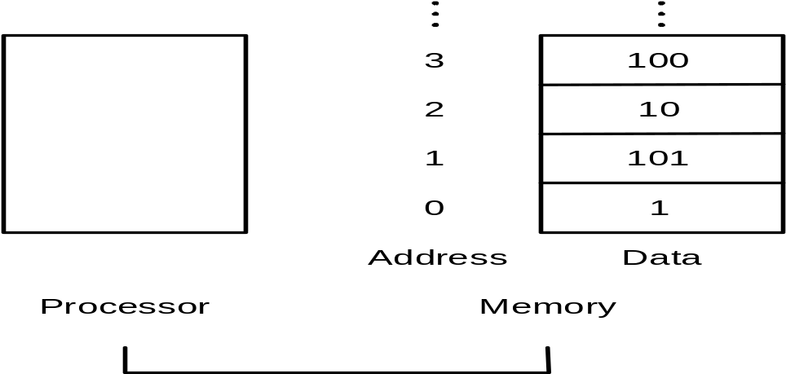
Memory operands
Save complex data structures(Arrays and structures)
Data transfer instructions
  Load: from memory to register; load word ( lw )
  Store: from register to memory; store word( sw )
Memory addresses and contents at those locations

Slide 15
Example:Compiling with an operand in memory
C code
C code
  g = h + A[8] ; // A is an array of 100 words
  ( Assume: g --- x20 h --- x21 base address of A --- x22 )
RISC-V code
  lw x9, 32(x22) // temporary reg x9 gets A[8]
  add x20, x21, x9 // g = h + A[8]
  Offset: the constant in a data transfer instruction →32
  Base register: the register added to form the address →x22
Byte/Half-word/word addressing
Alignment restriction
Endianness/byte order

Slide 16
Memory Alignment
struct {
int a;
char b;
char c[2];
char d[3]
float e;
}
正确
e
d[1]
d[2]
No use
No use
b
c[0]
c[1]
d[0]
a
错误
e
No use
No use
因为一次只能读出4字节内存中的一行
这样布局，e变量不能一次读出
d[1]
d[2]
e
b
c[0]
c[1]
d[0]
a

Slide 17
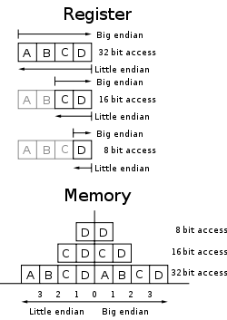
Endianness/byte order
Big endian: Leftmost
  PowerPC,IBM
  01 02 = 258
Little endian: Rightmost
  Intel,DEC
  01 02 = 513
Bi-endian
  MIPS,ARM,RISC-V

Slide 18
Example(p77):Compiling using load and store
C code:
  A[12] = h + A[8] ; // A is an array of 100 words
  ( Assume: h --- x21 base address of A --- x22 )
RISC-V code:
  lw x9 , 32(x22) // temporary reg x9 gets A[8]
  add x9, x21, x9 // temporary reg x9 gets h + A[8]
  sw x9, 48(x22) // stores h + A[8] back into A[12]

Slide 19
Registers vs. Memory
Registers are faster to access than memory
Operating on memory data requires loads and stores
  More instructions to be executed
Compiler must use registers for variables as much as possible
  Only spill to memory for less frequently used variables
  Register optimization is important!

Slide 20
Constant or immediate Operands
Many times a program will use a constant
in an operation
  Incrementing index to point to next element of array
  Add the constant 4 to register x22
  Assuming AddrConstants 4 is address pointer of constant 4
lw x9, AddrConstant4(x3) // x9=constant 4
add x22, x22, x9
Immediate: Other method for adding
constant 4 to x22
  Avoids the load instruction
  Offer versions of the instruction
  addi x22, x22, 4 // x22= x22+ 4
Constant zero: a register x0
Make the common case fast
  Constant operands occur frequently(it is very common).
  Loading them from memory is very slow.
x3
….
AddrConstants 4
4

Slide 21
signed and unsigned numbers
Bits are just bits (no inherent meaning)
  conventions define relationship between bits and numbers
Binary numbers (base 2)
0000 0001 0010 0011 0100 0101 0110 0111 1000 1001...
decimal: 0...2^{n}-1
Of course it gets more complicated
  numbers are finite (overflow)
  fractions and real numbers
  negative numbers
How do we represent negative numbers?
§2.4 signed and unsigned numbers

Slide 22
Unsigned Binary Integers
Given an n-bit number
Range: 0 to +2^{n} – 1
Example
  0000 0000 0000 0000 0000 0000 0000 1011₂
  = 0 + … + 1×2³ + 0×2² +1×2¹ +1×2⁰
  = 0 + … + 8 + 0 + 2 + 1 = 11₁₀
Using 64 bits
  0 to 2⁶⁴ -1(18,446,774,073,709,551,615)

Slide 23
2’s-Complement Signed Integers
Given an n-bit number
Range: –2^{n – 1} to +2^{n – 1} – 1
Example
  1111 1111 1111 1111 1111 1111 1111 1100₂
  = –1×2³¹ + 1×2³⁰ + … + 1×2² +0×2¹ +0×2⁰
  = –2,147,483,648 + 2,147,483,644 = –4₁₀
Using 64 bits
  –9,223,372,036,854,775,808 to + 9,223,372,036,854,775,807

Slide 24
2’s-Complement Signed Integers
Bit 31 is sign bit in a 32-bits integer
  1 for negative numbers
  0 for non-negative numbers
–(–2^{n – 1}) can’t be represented
Non-negative numbers have the same unsigned and 2s-complement representation
Some specific numbers
  0: 0000 0000 … 0000
  –1: 1111 1111 … 1111
  Most-negative: 1000 0000 … 0000
  Most-positive: 0111 1111 … 1111

Slide 25
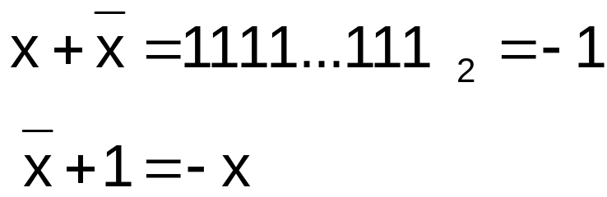
Signed Negation
Complement and add 1
  Complement means 1 → 0, 0 → 1
Example: negate +2
  +2 = 0000 0000 … 0010₂
  –2 = 1111 1111 … 1101₂ + 1
  = 1111 1111 … 1110₂

Slide 26
Sign Extension
Representing a number using more bits
  Preserve the numeric value
In RISC-V instruction set
  addi: extend immediate value
  lb, lh,lw: extend loaded byte/halfword/word
  beq, bne: extend the displacement
Replicate the sign bit to the left
  c.f. unsigned values: extend with 0s
Examples: 8-bit to 16-bit
  +2: 0000 0010 => 0000 0000 0000 0010
  –2: 1111 1110 => 1111 1111 1111 1110

Slide 27
Other representations
text characters
  ASCII,GB2312,BIG5,Unicode(UTF-8)
Floating point numbers(IEEE754)
  numeric calculations
  Different grades of precision
    Single precision
    Double precision
    Quadruple precision
Instructions in the Computer

Slide 28
Representing Instructions
All information in computer consists of binary bits
Mapping registers into numbers
  map registers x0 to x31 onto registers 0 to 31
Example(p87):Translating assembly into machine instruction
  RISC-V code：add x9, x20, x21
  Decimal version of machine code
  | 0 | 21 | 20 | 0 | 9 | 51 |
  Binary version of machine code
  | 0000000 | 10101 | 10100 | 000 | 01001 | 0110011 |
  7 bits 5 bits 5 bits 3 bits 5 bits 7 bits
§2.5 Representing Instructions in the computer

Slide 29
RISC-V fields (format)
R-type or R-format
| funct7 | rs2 | rs1 | funct3 | rd | opcode |
  7 bits 5 bits 5 bits 3 bits 5 bits 7 bits
  opcode : basic operation and format of an instruction.
  rd : the register destination operand.
  funct3: an additional opcode field.
  rs1: the first register source operand.
  rs2: the second register source operand.
  funct7: an additional opcode field.

Slide 30
RISC-V fields (format)
I-type or I-format
| immediate | rs1 | funct3 | rd | opcode |
  12 bits 5 bits 3 bits 5 bits 7 bits
  immediate : interpreted as a two’s complement value.
  lw x9, 32(x22)
S-type (store instruction)
| immediate[11:5] | rs2 | rs1 | funct3 | immediate[4:0] | opcode |
  7 bits 5 bits 5 bits 3 bits 5 bits 7 bits
  sw x9, 32(x22)

Slide 31
Design Principle 3
  Good design demands good compromises
All instructions in RISC-V have the same length
  Conflict: same length ←--→ single instrucion

Slide 32
Example(p91):Translating assembly into machine instruction
C code:
  A[30] = h + A[30] + 1 ;
  ( Assume: h ---- x21 base address of A ---- x10 )
RISC-V assembly code:
  lw x9, 120(x10) // temporary reg x9 gets A[30]
  add x9, x21, x9 // temporary reg x9 gets h + A[30]
  addi x9, x9, 1 // temporary reg x9 gets h + A[30] + 1
  sw x9, 120(x10) // stores h + A[30] + 1 back into A[30]
RISC-V machine language code:
  Decimal version
| immediate | rs1 | funct3 | rd | opcode |
  120 10 2 9 3
lw

Slide 33
| funct7 | rs2 | rs1 | funct3 | rd | opcode |
  0 9 21 0 9 51
| immediate | rs1 | funct3 | rd | opcode |
  1 9 0 9 19
| im[11:5] | rs2 | rs1 | funct3 | im[4:0] | opcode |
  3 9 10 2 24 35
Two key principles of today’s computers
  Instructions are represented as numbers
  Programs can be stored in memory like numbers
add
addi
sw
Stored-program

Slide 34
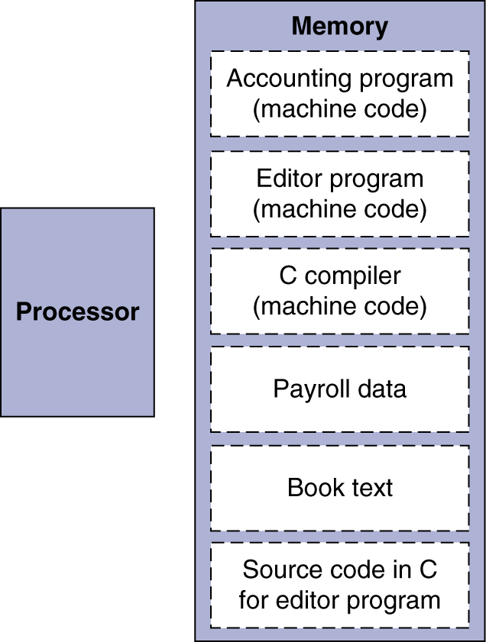
Stored-program concept
The BIG Picture
Instructions represented in binary, just like data
Instructions and data stored in memory
Programs can operate on programs
  e.g., compilers, linkers, …
Binary compatibility allows compiled programs to work on different computers
  Standardized ISAs

Slide 35
RISC-V instruction encoding
Name | Format | Example |  |  |  |  |  | Comment
add | R | 0 | 3 | 2 | 0 | 1 | 51 | add x1, x2, x3
sub | R | 32 | 3 | 2 | 0 | 1 | 51 | sub x1, x2, x3
addi | I | 1000 |  | 2 | 0 | 1 | 19 | addi x1,x2,1000
lw | I | 1000 |  | 2 | 2 | 1 | 3 | lw x1, 1000(x2)
sw | S | 31 | 1 | 2 | 2 | 8 | 35 | sw x1, 1000(x2)

Slide 36
Logical operations
Operating some bits within word or individual bit
§2.6 Logical operations
Logic operations | C operators | Java operators | RISC-V instructions
Shift left | << | << | sll, slli
Shift right | >> | >>> | srl, srli
Shift right arithmetic | >> | >> | sra, srai
Bit-by-bit AND | & | & | and, andi
Bit-by-bit OR | | | | | or, ori
Bit-by-bit XOR | ^ | ^ | xor, xori

Slide 37
Shift operator
  Move all the bits in a word to left or right, filling emptied bits with 0
  Shifting left by i is same result as multiplying by 2^{i}
  0000 0000 0000 0000 0000 0000 0000 1001 (9)₁₀
  Shift left 4
  0000 0000 0000 0000 0000 0000 1001 0000 (9×16=144)₁₀
  slli x11, x19, 4 // reg x11=reg x19 << 4 bit
immediate | rs1 | funct3 | rd | opcode
4 | 19 | 1 | 11 | 19

Slide 38
AND operator
  It is bit-by-bit
    Result=1 : both bits of the operands are 1
  x2:
  0000 0000 0000 0000 0000 1101 0000 0000
  x1:
  0000 0000 0000 0000 0011 1100 0000 0000
  and x0, x1, x2 //reg x0=reg x1 & reg x2
  Result:
  0000 0000 0000 0000 0000 1100 0000 0000

Slide 39
Instructions for making decisions
Branch instructions
  beq register1, register2, L1
  bne register1, register2, L1
Example:Compiling an if statement to a branch
  C code:( Assume: f ~ j ---- x19 ~ x23 )
if ( i = = j ) f = g + h ; else f = g – h;
  RISC-V assembly code:
bne x22, x23, ELSE // go to ELSE if i != j
add x19, x20, x21 // f = g + h ( skipped if i not equals j )
beq x0, x0, EXIT
ELSE: sub x19, x20, x21 // f = g - h ( skipped if i equals j ) EXIT:
§2.7 Instructions for making decisions
i==j?
i != j
F=g+h
F=g - h
Exit:

Slide 40
Example:Compiling a while loop
( Assume: i and k--- x22 and x24 base of save --- x25 )
C code:
  while ( save[i] = = k )
  i += 1 ;
RISC-V assembly code:
  Loop: slli x10, x22, 2 // Temp reg x10 = i * 4
  add x10, x10, x25 // x10 = address of save[i]
  lw x9, 0(x10) // x9 gets save[i]
  bne x9, x24, Exit // go to Exit if save[i] != k
  addi x22, x22, 1 // i += 1
  beq x0, x0, Loop // go to Loop
  Exit:

Slide 41
Other Compare Operation
  blt : less than
  bge: greater or equal
Unsigned Compare Operation version
  bltu : less than
  bgeu: greater or equal

Slide 42
Signed vs unsigned comparison
x5: 0xFFFFFFFF
x6: 0x00000001
blt x5,x6,Result
  signed integer: ?
  unsigned integer: ?

Slide 43
Case/Switch Statement
used to select one of many alternatives
Example
Compiling a switch using jump address table
( Assume: f ~ k ---- x20 ~ x25 x5 contains 4 )
  C code:
  switch ( k ) {
  case 0 : f = i + j ; break ; /* k = 0 */
  case 1 : f = g + h ; break ; /* k = 1 */
  case 2 : f = g - h ; break ; /* k = 2 */
  case 3 : f = i - j ; break ; /* k = 3 */
  }

Slide 44
Jump-and-link register
  jalr x1,100(x6)
jump address table
 | …………
P1 address | Program 1
 | …………
P2 address | Program 2
 | …………
P3 address | Program 3
 | …………
P4 address | Program 4
 | …………
k=0 | P1 address
k=1 | P2 address
k=2 | P3 address
k=3 | P4 address
x6

Slide 45
RISC-V assembly code:
  blt x25, x0, Exit // test if k < 0
  bge x25, x5, Exit // if k >= 4, go to Exit
  slli x7, x25, 2 // temp reg x7 = 4 * k
  add x7, x7, x6 // x7 = address of JumpTable[k]
  lw x7, 0(x7) // x7 gets JumpTable[k]
  jalr x1, 0(x7) // jump entrance
  Exit:
jump address table
L0: add x20, x23, x24 // k = 0 so f gets i + j
jalr x0, 0(x1) // end of this case so go to Exit
L1: add x20, x21, x22 // k = 1 so f gets g + h
jalr x0, 0(x1) // end of this case so go to Exit
L2: sub x20, x21, x22 // k = 2 so f gets g - h
jalr x0, 0(x1) // end of this case so go to Exit
L3: sub x20, x23, x24 // k = 3 so f gets i - j
jalr x0, 0(x1) //end of switch statement
L0:address
L1:address
L2: address
L3:address

Slide 46
Supporting Procedures in Computer Hardware
Procedure/function --- be used to structure programs
  A stored subroutine that performs a specific task based on the parameters with which it is provided
  easier to understand, allow code to be reused
  Six steps
    Place Parameters in a place where the procedure can access them
    Transfer control to the procedure
    Acquire the storage resources needed for the procedure
    Perform the desired task
    Place the result value in a place where the calling program can access it
    Return control to the point of origin
§2.8 Supporting Procedures in Computer Hardware

Slide 47
Registers for procedure calling
  x10~ x17: eight argument registers to pass parameters or return values
  x1: one return address register to return to origin point
Instruction for procedures: jal ( jump-and-link )
Caller: jal x1,ProcedureAddress
Callee: jalr x0, 0(x1)
Using more registers
  Stack: ideal data structure for spilling registers
    Push, pop
    Stack pointer ( x2 or sp )
PC+4→x1
Special registers

Slide 48
Example(p106):Compiling a leaf procedure
C code:( Assume: f ---- x20)
int leaf_example ( int g, int h, int i, int j )
  {
  int f ;
  f = ( g + h ) - ( i + j ) ;
  return f ;
  }
RISC-V assembly code:
  addi sp, sp,-12 // adjust stack to make room for 3 items
  sw x5, 8(sp)
  sw x6, 4(sp) // save temporary register x5,x6,x20
  sw x20, 0(sp)
add x5, x10, x11 // register x5 contains g + h
High address
(x5)
(x6)
(x20)
sp(-12)
Low address

Slide 49
add x6, x12, x13 // register x6 contains i + j
sub x20, x5, x6 // f = x5- x6, which is ( g + h ) – ( i + j )
add x10, x20, x0 // returns f ( x10 = x20 + 0)
lw x20, 0(sp) // restore register x20,x6,x5 for caller
lw x6, 4(sp)
lw x5, 8(sp)
addi sp, sp, 12 // adjust stack to delete 3 items
jalr x0, 0(x1) // jump back to calling routine
But maybe some of the three are not used by the caller.So,this way might be inefficient.
  Two classes of registers
    x5-x7 and x28-x31: 7 temporary registers , not preserved
    x8-x9 and x18-x27 : 12 saved registers, must be preserved

Slide 50
The values of the stack pointer and stack before, during and after procedure call in Example
High address
sp
sp
Content of register x5
Content of register x6
sp
Content of register x20
Low address
a
.
b
.
c
.

Slide 51
Nested Procedures:Compiling a recursive procedure
C code for n!
  int fact ( int n )
  {
  if ( n < 1 ) return ( 1 ) ;
  else return ( n * fact ( n - 1 ) ) ;
  }
RISC-V assembly code
fact: addi sp, sp, -8 // adjust stack for 2 items
  sw x1, 4(sp) // save the return address
  sw x10, 0(sp) // save the argument n
addi x5, x10, -1 // x5 = n - 1
bge x5, x0, L1 // if n >= 1, go to L1(else)
addi x10, x0, 1 // return 1 if n <1
addi sp, sp, 8 // Recover sp (Why not recover x1and x10 ?)
jalr x0, 0(x1) // return to caller
L1: addi x10, x10, -1 // n >= 1: argument gets ( n - 1 )
jal x1, fact // call fact with ( n - 1 )

Slide 52
add x6, x10, x0
lw x10, 0(sp) // restore argument n
lw x1, 4(sp) // restore the return address
addi sp, sp, 8 // adjust stack pointer to pop 2 items
mul x10, x10, x6 // return n*fact ( n - 1 )
jalr x0, 0(x1) // return to the caller
Why x10 is saved? Why x1 is saved?
Preserved things across a procedure call
  Saved registers, stack pointer register( sp ),return address register( x1 ), stack above the stack pointer
Not preserved things across a procedure call
  Temporary registers, argument registers( x10 ~ x17),return value registers ( x10 ~ x17), stack below the stack pointer

Slide 53
Storage class of C variables
  automatic
  static
Procedure frame and frame pointer ( x8 or fp )
  The importance of fp
  automatic
Global pointer ( x3 or gp )
  static

Slide 54
Allocating Space for New Data on the Stack
  Procedure frame/activation record
    The segment of stack containing a procedure’s saved registers and local variables
  Frame pointer
    A value denoting the location of saved register and local variables for a given procedure
High address
fp→
fp→
sp→
fp→
sp→
Saved argument
Registers (if any)
Saved return address
Local arrays and
structures(if any)
sp→
Low address

Slide 55
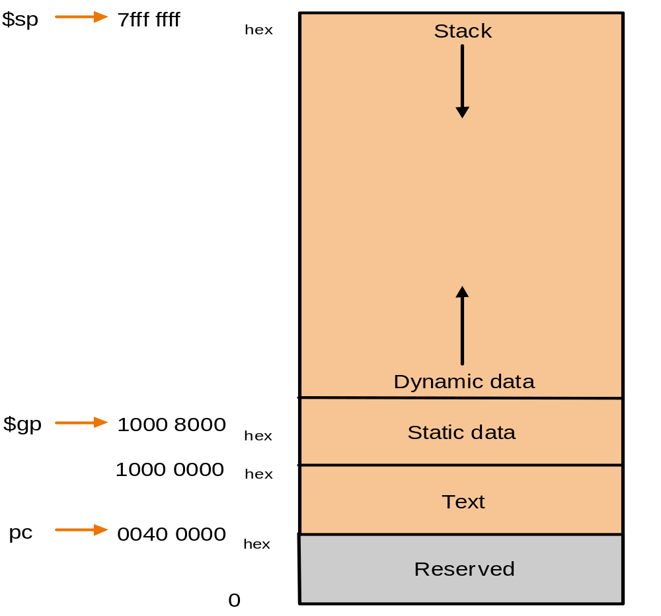
Allocating Space for New Data on the Heap

Slide 56
RISC-V register conventions
Name | Register name | Usage | Preserved On call?
x0 | 0 | The constant value 0 | n.a.
x1(ra) | 1 | Return address(link register) | yes
x2(sp) | 2 | Stack pointer | yes
x3(gp) | 3 | Global pointer | yes
x4(tp) | 4 | Thread pointer | yes
x5-x7 | 5-7 | Temporaries | no
x8-x9 | 8-9 | Saved | yes
x10-x17 | 10-17 | Arguments/results | no
x18-x27 | 18-27 | Saved | yes
x28-x31 | 28-31 | Temporaries | no

Slide 57
communication with people
ASCII (American Standard Code for Information Interchange)
Instructions for moving bytes in RISC-V
  Load byte unsigned ( lbu ):
  lbu x12, 0(x10) // read byte from source
  Store byte ( sb ):
  sb x12, 0(x10) // write byte to destination
Three choices for representing a string
  Place the length of the string in the first position
  An accompanying variable has the length
  A character in the last position to mark the end of a string
C uses the third choice
  Terminate a string with a byte whose value is 0 ( null in ASCII )
§2.9 Communication with people

Slide 58
Example:Compiling a string copy procedure
C code:y→x( Assume: i ---- x19 )
  void strcpy ( char x[ ] , char y[ ] )
  {
  size_t i ;
  i = 0 ;
  while ( ( x[ i ] = y[ i ] ) != ‘\ 0’ ) /* copy and test byte */
  i += 1 ;
  }
RISC-V assembly code:
  strcpy: addi sp, sp, -4 // adjust stack for 1 more item
  sw x19, 0(sp) // save x19
  add x19, x0, x0 // i = 0
  L1: add x5, x19, x11 // address of y[ i ] in x5
  lbu x6, 0(x5) // x6 = y [ i ]
  add x7, x19, x10 // address of x[ i ] in x7
  sb x6, 0(x7) // x[ i ] = y[ i ]

Slide 59
beq x6, x0, L2 // if y[ i ] == 0, go to L2
addi x19, x19, 1 // i = i + 1
jal x0, L1 // go to L1
L2: lw x19, 0(sp) // restore x19
addi sp, sp, 4 // pop 1 word off stack
jalr x0, 0(x1) // return
Optimization for example
  strcpy is a leaf procedure
  Allocate i to a temporary register x28
For a leaf procedure
  The compiler exhausts all temporary registers
  Then use the registers it must save

Slide 60
RISC-V Addressing for Wide Immediate and Addresses
Wide Immediate addressing
  most constants is short and fit into 12-bit field, sometimes they are bigger.
  Set upper 20 bits of a constants in a register with load upper immediate (lui), it uses a new instruction format (U-type)
| imm[31:12] | rd | opcode |
  20bits 5 bits 7 bits
  Loading a 32-bit Constant ( x19 = 0x12345678)
    lui x19 , 0x12345
    addi x19, x19, 0x678
    Note:Why does it need two steps?
§2.10 RISC-V Addressing for Wide Immediate and Addresses

Slide 61
Addressing in branches
  SB-type: bne x10, x11, 2000
  UJ-type:jal x0, 2000
  PC-relative addressing : PC = PC + Branch offset
0 | 111110 | 01011 | 01010 | 001 | 1000 | 0 | 1100111
imm[12] | imm[10:5] | rs2 | rs1 | funct3 | imm[4:1] | imm[11] | opcode
§2.10 RISC-V Addressing for Wide Immediate and Addresses
0 | 1111101000 | 0 | 00000000 | 00000 | 1101111
imm[20] | imm[10:1] | imm[11] | imm[19:12] | rd | opcode

Slide 62
Example (p123):Show branch offset in machine language
C language (p100):
while (save[i]==k) i=i+1;
RISC-V assembler code :
Loop: slli x10, x22, 2 // temp reg x10 = 4 * i
  add x10, x10, x25 // x10 = address of save[i]
  lw x9, 0(x10) // temp reg x9 = save[i]
  bne x9, x24, Exit // go to Exit if save[i] != k
  addi x22, x22, 1 // i = i + 1
  beq x0, x0, Loop // go to Loop
  Exit:

Slide 63
Assembled instructions and their addresses:
80000 | 0 | 2 | 22 | 1 | 10 | 19 |
80004 | 0 | 25 | 10 | 0 | 10 | 51 |
80008 | 0 | 0 | 10 | 3 | 9 | 3 |
80012 | 0 | 24 | 9 | 1 | 12 | 103 |
80016 | 0 | 1 | 22 | 0 | 22 | 19 |
80020 | 127 | 0 | 0 | 0 | 13 | 99 |
80024 . . .
Modification:
  All RISC-V instructions are 4 bytes long
  PC-relative addressing refers to the number of halfwords
slli
add
lw
bne
addi
beq
PC+offset=80012+6*2=80024

Slide 64
While branch target is far away
  Inserts an unconditional jump to target
  Invert the condition so that the branch decides whether to skip the jump
Example:Branching far away
  Given a branch:
  beq x10, x0, L1
  Rewrite it to offer a much greater branching distance:
    bne x10, x0, L2
    jal x0, L1
    L2:

Slide 65
RISC-V addressing mode summary
  Immediate addressing
  addi x5,x6,4
  Register addressing
  add x5,x6,x7
  Base addressing
  lw x5,100(x6)
  PC-relative addressing
  beq x5,x6,L1

Slide 66
Example (p127):Decoding machine code
Machine instruction (0x00578833)
  0000 0000 0101 0111 1000 1000 0011 0011
Decoding
  Determine the operation from opcode
    opcode: 0110011 → R-type arithmetic instruction
| funct7 | rs2 | rs1 | funct3 | rd | opcode |
  0000000 00101 01111 000 10000 0110011
  funct7 and funct3 are all 0 → add instruction
  Determine other fields
    rs2: x5; rs1: x15; rd: x16
  Show the assembly instruction
    add x16, x15, x5 (Note: add rd,rs1,rs2)

Slide 67
Summary of RISC-V instruction encoding
Format | Instruction | Opcode | Funct3 | Funct6/7
R-type | add | 0110011 | 000 | 0000000
 | sub | 0110011 | 000 | 0100000
 | sll | 0110011 | 001 | 0000000
 | xor | 0110011 | 100 | 0000000
 | srl | 0110011 | 101 | 0000000
 | sra | 0110011 | 101 | 0000000
 | or | 0110011 | 110 | 0000000
 | and | 0110011 | 111 | 0000000
 | lr.w | 0110011 | 011 | 0001000
 | sc.w | 0110011 | 011 | 0001100

Slide 68
Format | Instruction | Opcode | Funct3 | Funct6/7
I-type | lb | 0000011 | 000 | n.a.
 | lh | 0000011 | 001 | n.a.
 | lw | 0000011 | 010 | n.a.
 | ld | 0000011 | 011 | n.a.
 | lbu | 0000011 | 100 | n.a.
 | lhu | 0000011 | 101 | n.a.
 | lwu | 0000011 | 110 | n.a.
 | addi | 0010011 | 000 | n.a.
 | slli | 0010011 | 001 | 000000
 | xori | 0010011 | 100 | n.a.
 | srli | 0010011 | 101 | 000000
 | srai | 0010011 | 101 | 010000
 | ori | 0010011 | 110 | n.a.
 | andi | 0010011 | 111 | n.a.
 | jalr | 1100111 | 000 | n.a.

Slide 69
Format | Instruction | Opcode | Funct3 | Funct6/7
S-type | sb | 0100011 | 000 | n.a.
 | sh | 0100011 | 001 | n.a.
 | sw | 0100011 | 010 | n.a.
 | sd | 0100011 | 111 | n.a.
SB-type | beq | 1100111 | 000 | n.a.
 | bne | 1100111 | 001 | n.a.
 | blt | 1100111 | 100 | n.a.
 | bge | 1100111 | 101 | n.a.
 | bltu | 1100111 | 110 | n.a.
 | bgeu | 1100111 | 111 | n.a.
U-type | lui | 0110111 | n.a. | n.a.
UJ-type | jal | 1101111 | n.a. | n.a.

Slide 70
Parallelism and Instructions: Synchronization
cause
  multiprocessors
  task preemption
  interrupt
result
  data race
  resources race
  Critical region
solution
  synchronization
    mutual exclusion、semaphore …
  hardware level
    atomic exchange or atomic swap (instructions in RISC-V: lr.w and sc.w)
§2.11 Parallelism and Instructions: Synchronization
Notes:
1.1 Introduction
70

Slide 71
a pair of instructions
  lr.w: load-reserved word
  sc.w: store-conditional word. If the contents of the memory location specified by lr.w are changed before the sc.w to the same address occurs, then the store-conditional fails and does not write the value to memory.
Example:implements an atomic exchange
  again: lr.w x10, (x20) // load reserved
  sc.w x11, x23 , (x20) // store conditional
  bne x11, x0, again // branch if store fails
  addi x23, x10, 0 // put loaded value in x23
Notes:
1.1 Introduction
71

Slide 72
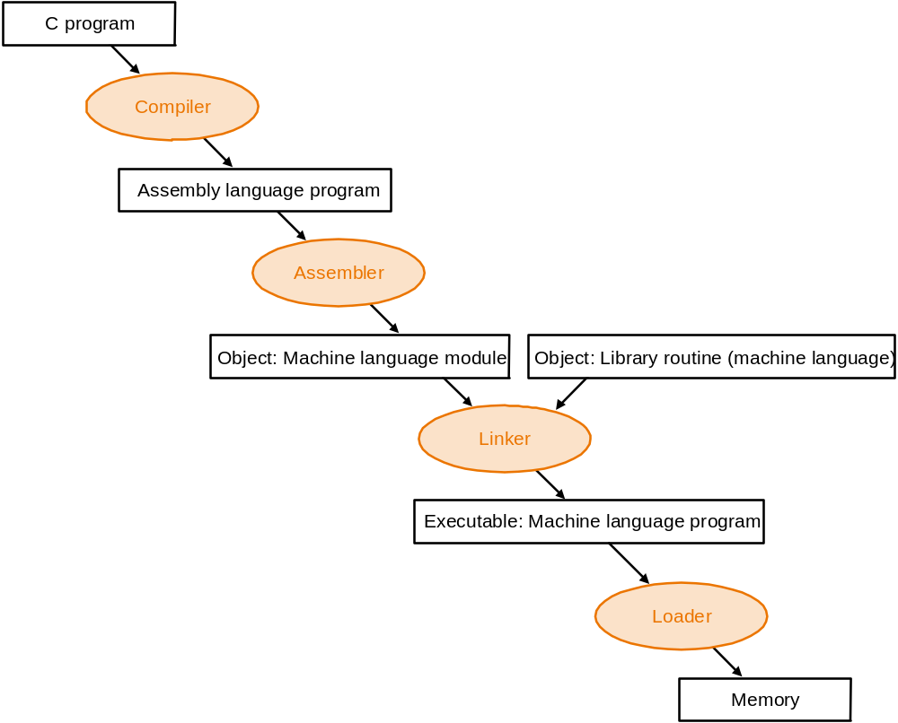
Translating and Starting a Program
§2.12 Translating and Starting a Program

Slide 73
Start a C program in a file on disk to run
object file
Compiling
  C program → assembly language program
Assembling
  Assembly language program → machine language module
  pseudoinstructions
  li x9, 123 // load immediate value 123 into register x9
  addi x9, x0, 123
    mv x10,x11 // register x10 gets register x11
    add x10, x11, x0
  Symbol table
    A table that matches name of lables to the addresses of the memory words that instructions occupy.
  Object file of UNIX (six distinct pieces)
    object file header—size and position of the other pieces
    Text segment
    static data segment and dynamic data

Slide 74
The relocation information: identifies absolute addresses of instruction and data words when the program is loaded into memory
symbol table
debugging
information
Object file header
 | Name | Procedure A
 | Text size | 100_{hex}
 | Data size | 20_{hex}
Text segment | Address | instruction
 | 0 | lw x10, 0(gp)
 | 4 | jal x1, 0
 | …… | --
Data segment | 0 | (X)
 | …… | ……
Relocation information | Address | Instruction type | Dependency
 | 0 | lw | X
 | 4 | jal | B
Symbol table | label | Address
 | X | --
 | B | --

Slide 75
Linking
  Object modules(including library routine) → executable program
  3 step of Link
    Place code and data modules symbolically in memory
    Determine the addresses of data and instruction labels
    Patch both the internal and external references (Address of invoke)
sp
7FFF FFFc_{hex}
Stack
RISC-v memory allocation for program and data
Dynamic data
gp
1000 8000_{hex}
Static data
1000 0000_{hex}
Text
PC
0040 0000_{hex}
Reserved
0

Slide 76
Loading
  Determine size of text and data segments
  Create an address space large enough
  Copy instructions and data from executable file to memory
  Copy parameters (if any) to the main program onto the stack
  Initialize registers and set sp to the first free location
  Jump to a start-up routine

Slide 77
A C Sort Example To Put it All Together
Three general steps for translating C procedures
  Allocate registers to program variables
  Produce code for the body of the procedures
  Preserve registers across the procedures invocation
Procedure swap
  C code
  void swap ( int v[ ] , size_t k )
  {
  int temp ;
  temp = v[ k ] ;
  v[ k ] = v[ k + 1 ] ;
  v[ k + 1 ] = temp ;
  }
§2.13 A C Sort Example To Put it All Together

Slide 78
Register allocation for swap
  v ---- x10 k ---- x11 temp ---- x5
swap is a leaf procedure, nothing to preserve
RISC-V code for the procedure swap
  Procedure body
  swap: slli x6, x11, 2 // x6 = k * 4
  add x6, x10, x6 // x6 = v + ( k * 4 )
  lw x5, 0(x6) // x5 ← v[ k ]
  lw x7, 4(x6) // x7 ← v[ k + 1 ]
  sw x7, 0(x6) // v[k+1] → v[ k ]
  sw x5, 4(x6) // v[k] → v[ k + 1 ]
  Procedure return
  jalr x0, 0(x1) // return to calling routine

Slide 79
Procedure sort
  C code
  void sort (int v[ ] , size_t n )
  {
  size_t i , j ;
  for ( i = 0 ; i < n ; i + = 1 ) {
  for ( j = i - 1 ; j >= 0 && v[j] > v[j+1] ; j -= 1 )
  swap ( v , j ) ;
  }
  }
  Register allocation for sort
  v ---- x10 n ---- x11 i ---- x19 j ---- x20
  Passing parameters in sort
  Preserving registers in sort
  x1,x19,x20,x21,x22
If V[0]> V[1]
V[0]
V[1]
V[2]
……
V[n-1]

Slide 80
Code for the procedure sort
  Saving registers
  sort: addi sp, sp, -20 // make room on stack for 5 registers
  sw x1, 16(sp) // save return address on stack
  sw x22, 12(sp) // save x22 on stack
  sw x21, 8(sp) // save x21 on stack
  sw x20, 4(sp) // save x20 on stack
  sw x19, 0(sp) // save x19 on stack
  Procedure body{Outer loop {Inner loop} }
  Restoring registers
  exit1: lw x19, 0(sp) // restore x19 from stack
    lw x20, 4(sp) // restore x20 from stack
    lw x21, 8(sp) // restore x21 from stack
    lw x22, 12(sp) // restore x22 from stack
    lw x1, 16(sp) // restore return address from stack
    addi sp, sp, 20 // restore stack pointer
  Procedure return
    jalr x0, 0(x0) // return to calling routine

Slide 81
Code for Procedure body
  Outer loop : first for loop
  for ( i = 0 ; i < n ; i + = 1 ) {
    Move parameters
      mv x21, x10 // copy parameter x10 into x21
      mv x22, x11 // copy parameter x11 into x22
    Outer loop
      li x19, 0 // i = 0
  for1tst: bge x19, x22, exit1 // go to exit1 if i >= n
      ………………
      （body of first for loop is second for loop）
      ………………
  addi x19, x19, 1 // i = i + 1
  j for1tst // jump to test of outer loop
  exit1:

Slide 82
  Inner loop : second for loop is body of first for loop
  for ( j = i - 1 ; j >= 0 && v[j] > v[j+1] ; j- = 1 ){
      addi x20, x19, -1 // j = i - 1
for2tst: blt x20, x0, exit2 // go to exit2 if j < 0
    slli x5, x20, 2 // x5 = j * 4
    add x5, x21, x5 // x5 = the address of v[j]
    lw x6, 0(x5) // x6 = v[j]
    lw x7, 4(x5) // x7 = v[j + 1]
    blt x6, x7, exit2 // go to exit2 if v[j] < v[j+1]
      ………………
      （body of second for loop ）
    ………………
    addi x20, x20, -1 // j = j - 1
    j for2tst // jump to test of inner loop
  exit2:

Slide 83
    body of second for loop
      Pass parameters and call
    mv x10，x21 // first swap parameter v
    mv x11，x20 // second swap parameter j
      Call function swap
    jal x1, swap
Notice:
  Why are x10 and x11 saved?
    x10 is the base of the array v. x10 will be used repeatedly and might be(actually not here) changed by the procedure swap.
    x11 is the size of the array v. x11 will be used repeatedly and changed before the procedure swap is called.
  Why are they not pushed to stack?
    Register variable is faster

Slide 84
Arrays versus Pointers
Two C procedures
  Array version
  void clear1 ( int array[ ], size_t size )
  {
  siaze_t i;
  for ( i = 0 ; i < size ; i = i + 1 )
  array[i] = 0;
  }
  Pointer version
  void clear2 ( int *array, size_t size )
  {
    int *p;
    for ( p = &array[0] ; p < &array[size] ; p = p + 1 )
    *p = 0;
    }
§2.14 Arrays versus Pointers

Slide 85
Assembly code for clear-1 procedure (array version)
  mv x5, x0 // i = 0
  loop1: slli x6, x5, 2 // x6 = i * 4
  add x7, x10, x6 // x7 = address of array[ i ]
  sw x0, 0(x7) // array[ i ] = 0
  addi x5, x5, 1 // i = i +1
  blt x5, x11, loop1 // if ( i < size ) go to loop1
  jalr x0, 0(x1)
  This code works as long as size is greater than 0.
  (In this case,the loop will be executed once even though the value of the size parameter is invalid. Actually,size >0 must be checked at first)

Slide 86
Assembly code for clear-2 procedure (pointer version)
  mv x5, x10 // p = the start address of the array[]
  slli x6, x11, 2
  add x7, x10, x6 // x7 = &array[size](address of array[size] )
  loop2: sw x0, 0(x5) // Memory[ p ] = 0
  addi x5, x5, 4 // p = p + 4
  bltu x5, x7, loop2 // if ( p < &array[size] ) go to loop2
  jalr x0, 0(x1)
  This code works as long as size is greater than 0.
Compare the two versions
  Array version has the “multiply” and add inside loop
  Pointer version reduces instructions/iteration from 5 to 3
For modern compliers,both ways are the same

Slide 87
Concluding Remarks
Two principles of stored-program computers
  Use instructions as numbers
  Use alterable memory for programs
Three design principles
  Simplicity favors regularity
  Smaller is faster
  Good design demands good compromises
§2.23 Concluding Remarks

